Slide 1
ModuleIII
Transaction Management & concurrency control

Slide 2
Transactions
Collections of operations that form a single logical unit of work are called transactions.
A database system must ensure proper execution of transactions despite failures—either the entire transaction executes, or none of it does.
Transaction is a unit of program execution that accesses and possibly updates various data items.

Slide 3
What is a Transaction?
Any action that reads from and/or writes to a database may consist of
Simple SELECT statement to generate a list of table contents
A series of related UPDATE statements to change the values of attributes in various tables
A series of INSERT statements to add rows to one or more tables
A combination of SELECT, UPDATE, and INSERT statements

Slide 4
What is a Transaction?
A logical unit of work that must be either entirely completed or aborted
Successful transaction changes the database from one consistent state to another
One in which all data integrity constraints are satisfied
Most real-world database transactions are formed by two or more database requests
The equivalent of a single SQL statement in an application program or transaction

Slide 5
Evaluating Transaction Results
Not all transactions update the database
SQL code represents a transaction because database was accessed
Improper or incomplete transactions can have a devastating effect on database integrity
Some DBMSs provide means by which user can define enforceable constraints based on business rules
Other integrity rules are enforced automatically by the DBMS when table structures are properly defined, thereby letting the DBMS validate some transactions

Slide 6
Transaction Properties(ACID properties)
Atomicity
Requires that all operations (SQL requests) of a transaction be completed; if not, then the transaction is aborted
A transaction is treated as a single, indivisible, logical unit of work
This “all-or-none” property is referred to as atomicity.
Consistency
Consistency property ensures that the database must remain in the consistent state before the start of transaction and after the transaction is over.
Consistency states that only valid data will be written to the database.
If for some reason a transaction is executed that violates the database consistency rules the entire transaction will be rolled back.

Slide 7
Isolation
Data used during execution of a transaction cannot be used by second transaction until first one is completed
Even though multiple transactions may execute concurrently, the system guarantees that, for every pair of transactions Ti and Tj , it appears to Ti that either Tj finished execution before Ti started, or Tj started execution after Ti finished.

Slide 8
Durability
After a transaction completes successfully, the changes it has made to the database persist, even if there are system failures.
Durability can be implemented by writing all transaction into a transaction log that can be used to crate a system state right before failure.
A transaction can only regard as committed after it is written safely in the log.
For example, in an application that transfers funds from one account to another, the durability property ensures that the changes made to each account will not be reversed.
These properties are called the ACID properties.

Slide 9
Transaction State
A transaction must be in one of the following states:
Active:-
The initial state; the transaction stays in this state while it is executing.
Partially committed:-
After the final statement has been executed.
Failed:-
After the discovery that normal execution can no longer proceed.

Slide 10
Transaction State
Aborted:-
After the transaction has been rolled back and the database has been restored to its state prior to the start of the transaction
Committed:-
After successful completion

Slide 11
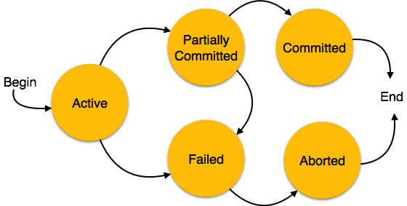

Slide 12
Transaction Management with SQL
ANSI has defined standards that govern SQL database transactions
Transaction support is provided by two SQL statements: COMMIT and ROLLBACK
ANSI standards require that, when a transaction sequence is initiated by a user or an application program,it must continue through all succeeding SQL statements until one of four events occurs

Slide 13
Transaction Management with SQL
A COMMIT statement is reached- all changes are permanently recorded within the database
A ROLLBACK is reached – all changes are aborted and the database is restored to a previous consistent state
The end of the program is successfully reached – equivalent to a COMMIT
The program abnormally terminates and a rollback occurs

Slide 14
The Transaction Log
Keeps track of all transactions that update the database. It contains:
A record for the beginning of transaction
For each transaction component (SQL statement)
Type of operation being performed (update, delete, insert)
Names of objects affected by the transaction (the name of the table)
“Before” and “after” values for updated fields
Pointers to previous and next transaction log entries for the same transaction
The ending (COMMIT) of the transaction
Increases processing overhead but the ability to restore a corrupted database is worth the price

Slide 15
The Transaction Log
Increases processing overhead but the ability to restore a corrupted database is worth the price
If a system failure occurs, the DBMS will examine the log for all uncommitted or incomplete transactions and it will restore the database to a previous state
The log it itself a database and to maintain its integrity many DBMSs will implement it on several different disks to reduce the risk of system failure

Slide 16
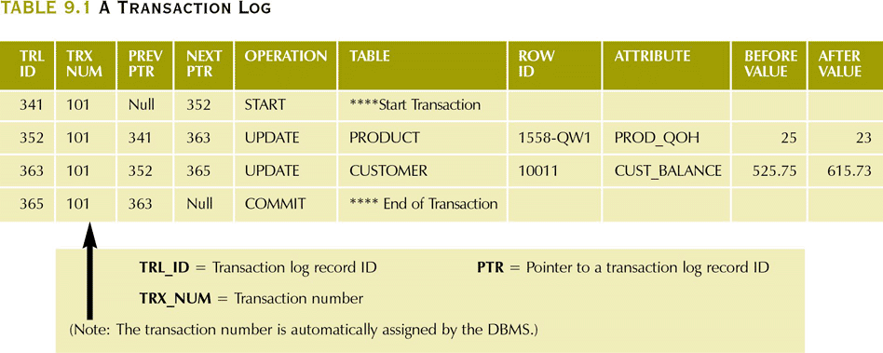
A Transaction Log

Slide 17
Transactions and schedules
A transaction is seen by the dbms as a series or list of actions.
Actions include read and writes of database object.
Assume that an object O is always read into a program variable that is also named O
Denote transaction T reading an object O as R_{T}(O)
Similarly writing as W_{T}(O)

Slide 18
Each transaction must specify as its final action either commit or abort
Abort_{T} and Commit_{T}
Schedule is a list of actions from a set of transactions,
Schedule represents an actual or potential execution sequence.

Slide 19
T1 T2
R(A)
W(A)
R(B)
W(B)
R(C)
W(C)

Slide 20
A schedule that contains either abort or commit for each transactions is called complete schedule.
If transactions are executed from start to finish,one by one----serial schedule

Slide 21
Concurrent execution of Transactions
Transaction processing system usually allow multiple transaction to run concurrently.
Allowing multiple transaction to run concurrently and allowing multiple transaction to update data concurrently causes several complications with consistency of data.
Ensuring consistency with concurrency require an extra work.

Slide 22
Concurrent execution of Transactions
Two reasons to allow concurrency are:-
Improve throughput and resource utilization:-(Throughput – Number of transactions that can be executed in a given amount of time.)
Reduced waiting time.

Slide 23
There may be a mix of transactions running on a system, some short and some long.
If transactions are run serially, a short transaction may have to wait for a preceding long transaction to complete, which can lead to unpredictable delays in running a transaction.
But concurrent execution reduces the unpredictable delays in running transactions.

Slide 24
TYPES OF SCHEDULE
1. Serial Schedule
2. Non-serial Schedule
3. Serializable schedule

Slide 25
1. Serial Schedule
The serial schedule is a type of schedule where one transaction is executed completely before starting another transaction.
In the serial schedule, when the first transaction completes its cycle, then the next transaction is executed.
For example: Suppose there are two transactions T1 and T2 which have some operations.

Slide 26
Execute all the operations of T1 which was followed by all the operations of T2.
Execute all the operations of T2 which was followed by all the operations of T1.
In the given (a) figure, Schedule A shows the serial schedule where T1 followed by T2.
In the given (b) figure, Schedule B shows the serial schedule where T2 followed by T1.

Slide 27
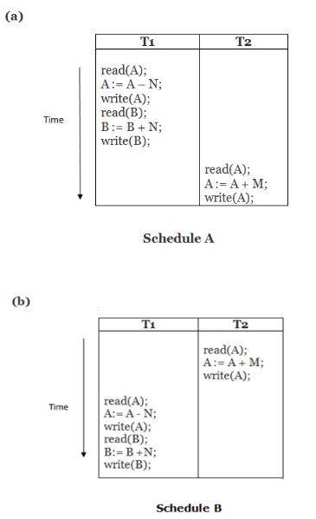
If it has no interleaving of operations, then there are the following two possible outcomes:

Slide 28
2. Non-serial Schedule/ Concurrent Execution
If interleaving of operations is allowed, then there will be non-serial schedule.
It contains many possible orders in which the system can execute the individual operations of the transactions.
In the given figure (c) and (d), Schedule C and Schedule D are the non-serial schedules. It has interleaving of operations.

Slide 29
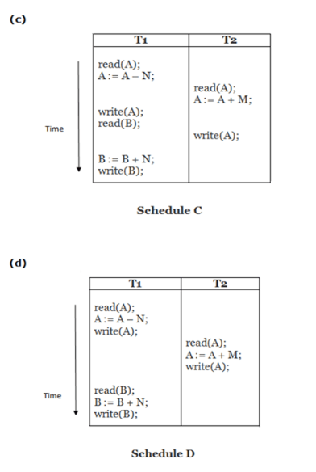
Non-serial Schedule

Slide 30
Problems with Concurrent Execution
In a database transaction, the two main operations are READ and WRITE operations. So, there is a need to manage these two operations in the concurrent execution of the transactions.
following problems occur with the Concurrent Execution of the operations:
Problem 1: Lost Update Problems (W - W Conflict)
Dirty Read Problems (W-R Conflict)
Unrepeatable Read Problem (W-R Conflict)/ Inconsistent Retrievals Problem

Slide 31
Problem 1: Lost Update Problems (W - W Conflict)
The problem occurs when two different database transactions perform the read/write operations on the same database items in an interleaved manner (i.e., concurrent execution) that makes the values of the items incorrect hence making the database inconsistent.
Consider the below diagram where two transactions T_{X} and T_{Y}, are performed on the same account A where the balance of account A is $300.

Slide 32
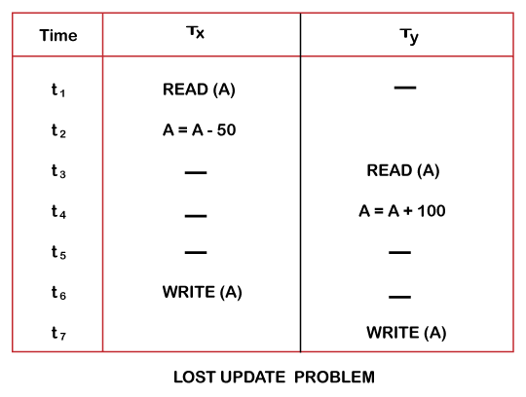

Slide 33
At time t1, transaction T_{X} reads the value of account A, i.e., $300 (only read).
At time t2, transaction T_{X} deducts $50 from account A that becomes $250 (only deducted and not updated/write).
Alternately, at time t3, transaction T_{Y} reads the value of account A that will be $300 only because T_{X} didn't update the value yet.
At time t4, transaction T_{Y} adds $100 to account A that becomes $400 (only added but not updated/write).
At time t6, transaction T_{X} writes the value of account A that will be updated as $250 only, as T_{Y} didn't update the value yet.
Similarly, at time t7, transaction T_{Y} writes the values of account A, so it will write as done at time t4 that will be $400. It means the value written by T_{X} is lost, i.e., $250 is lost.
Hence data becomes incorrect, and database sets to inconsistent.

Slide 34
Dirty Read Problems (W-R Conflict) / Uncommitted Data
The dirty read problem occurs when one transaction updates an item of the database, and somehow the transaction fails, and before the data gets rollback, the updated database item is accessed by another transaction. There comes the Read-Write Conflict between both transactions.

Slide 35
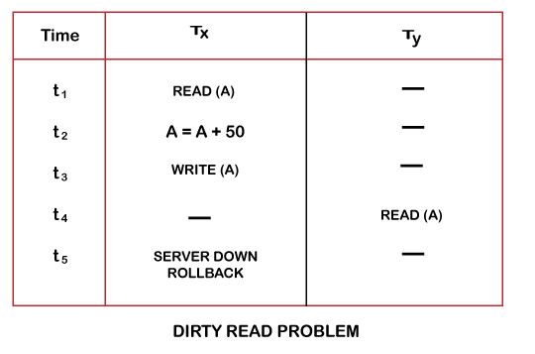

Slide 36
At time t1, transaction T_{X} reads the value of account A, i.e., $300.
At time t2, transaction T_{X} adds $50 to account A that becomes $350.
At time t3, transaction T_{X} writes the updated value in account A, i.e., $350.
Then at time t4, transaction T_{Y} reads account A that will be read as $350.
Then at time t5, transaction T_{X} rollbacks due to server problem, and the value changes back to $300 (as initially).
But the value for account A remains $350 for transaction T_{Y} as committed, which is the dirty read and therefore known as the Dirty Read Problem.

Slide 37
Unrepeatable Read Problem (W-R Conflict) / Inconsistent Retrievals Problem
Also known as Inconsistent Retrievals Problem that occurs when in a transaction, two different values are read for the same database item.

Slide 38
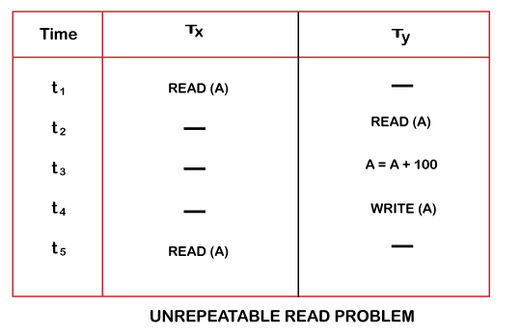

Slide 39
Serializability
When multiple transactions run concurrently, then it may give rise to inconsistency of the database.
Serializability is a concept that helps to identify which non-serial schedules are correct and will maintain the consistency of the database.
If a given schedule of ‘n’ transactions is found to be equivalent to some serial schedule of ‘n’ transactions, then it is called as a serializable schedule.

Slide 40
Difference between Serial Schedules and Serializable Schedules-
The only difference between serial schedules and serializable schedules is that-
In serial schedules, only one transaction is allowed to execute at a time i.e. no concurrency is allowed.
Whereas in serializable schedules, multiple transactions can execute simultaneously i.e. concurrency is allowed.

Slide 41
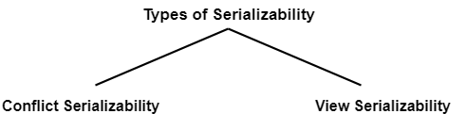
Types of Serializability

Slide 42
Conflict Serializability
A schedule is called conflict serializable if it can be transformed into a serial schedule by swapping non-conflicting operations.
Let us consider a schedule S in which there are two consecutive instructions ,I_{i} and I_{j} of transactions T_{i} and T_{j} ,respectively(i!=j).

Slide 43
If I_{i} and I_{j} refer to different data items ,then we can swap I_{i} and Ij ,without affecting the results of any instruction in the schedule.
However ,if Ii and Ij refer to the same data item Q,then the order of the two steps may matter.

Slide 44
There are four cases we need to consider
Ii=read(Q) ,Ij =read(Q), the order of Ii and Ij does not matter
Ii=read(Q) ,Ij =Write(Q),
If Ii comes before Ij ,then Ti doesnot read the value of Q that is written by Tj in instruction Ij.thus the order of Ii and Ij matters
Ii=Write(Q) ,Ij =read(Q), the order of Ii and Ij matter
Ii=write(Q) ,Ij =write(Q), the order of Ii and Ij does not matter,how ever the value obtained by the next read(Q)instn is affected.

Slide 45
If a schedule S can be transformed into a schedule S’ by a series of swaps of non-conflicting instructions ,we say that S and S’ are conflit equivalent.
A Schedule S is conflict serializable if it is conflict equivalent

Slide 46
A schedule is called conflict serializable if it can be transformed into a serial schedule by swapping non-conflicting operations.
Two operations are said to be conflicting if all conditions satisfy:
They belong to different transactions
They operate on the same data item
At Least one of them is a write operation

Slide 47
Precedence Graph
Precedence Graph or Serialization Graph is used commonly to test Conflict Serializability of a schedule.
It is a directed Graph (V, E) consisting of a set of nodes V = {T₁, T₂, T₃……….T_{n}} and a set of directed edges E = {e₁, e₂, e₃………………e_{m}}.

Slide 48
The graph contains one node for each Transaction T_{i}.
An edge e_{i} is of the form T_{j} –> T_{k.}
where T_{j} is the starting node of e_{i} and T_{k} is the ending node of e_{i}.
An edge e_{i} is constructed between nodes T_{j} to T_{k} if one of the operations in T_{j} appears in the schedule before some conflicting operation in T_{k} .

Slide 49
ALGORITHM
Create a node T in the graph for each participating transaction in the schedule.
Check for conflicting instructions in the schedule:-
For the conflicting operation read_item(X) and write_item(X)(RW Conflict) – If a Transaction Ti executes a read_item (X) after Tj executes a write_item (X), draw an edge from Ti to Tj in the graph.
For the conflicting operation write_item(X) and read_item(X)(i.e WR conflict) – If a Transaction Ti executes a write_item (X) after Tj executes a read_item (X), draw an edge from Ti to Tj in the graph.

Slide 50
ALGORITHM
For the conflicting operation write_item(X) and write_item(X) (i.e WW conflict)– If a Transaction Tj executes a write_item (X) after Ti executes a write_item (X), draw an edge from Ti to Tj in the graph.
The Schedule S is serializable if there is no cycle in the precedence graph.
If there is no cycle in the precedence graph, it means we can construct a serial schedule S’ which is conflict equivalent to the schedule S.

Slide 51

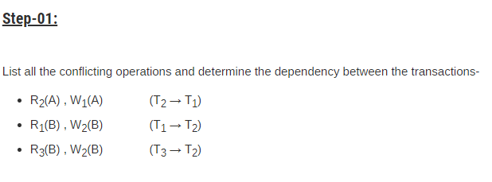
PROBLEM 1
SOLUTION

Slide 52
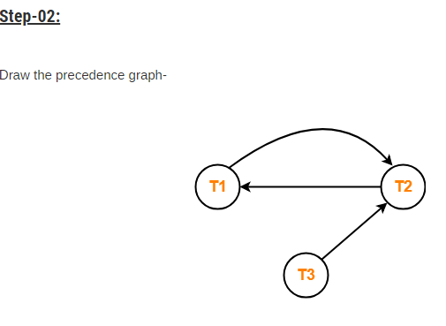
Clearly, there exists a cycle in the precedence graph.
Therefore, the given schedule S is not conflict serializable.

Slide 53
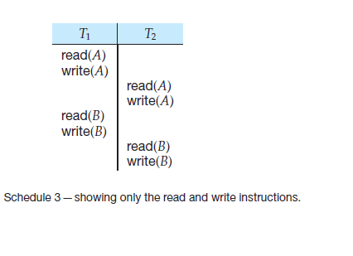
Example: conflict serializable and conflict equivalent

Slide 54
CONFLICT EQUIVALENT
Using precedence graph we found that the schedule 3 is conflict serializable since no cycles formed in graph.
If a schedule S can be transformed into a schedule S’ by a series of swapping of non conflicting instruction ,then we can say S and S’ are conflict equivalent.
Adjacent non conflicting pairs are swapped by position

Slide 55
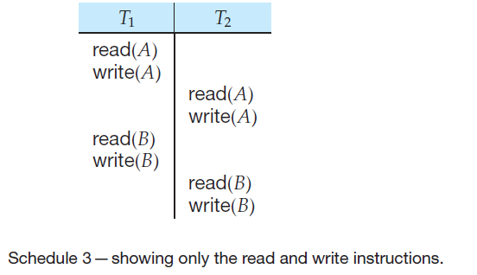
Example :CONFLICT EQUIVALENT
Consider schedule 3 which is conflict serializable.

Slide 56
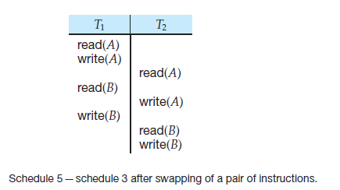
Example :conflict equivalent(conti..)
To find the conflict equivalent of the schedule 3 we need to perform certain swapping, i.e swapping of positions of non conflicting adjacent instructions in T1 and T2

Slide 57
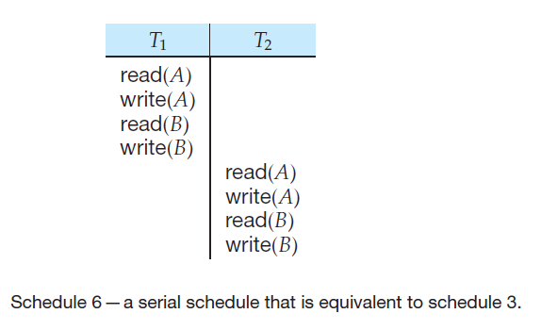
Example :conflict equivalent(conti..)
After a series of swapping we will get a serial schedule which is conflict equivalent of schedule 3.

Slide 58
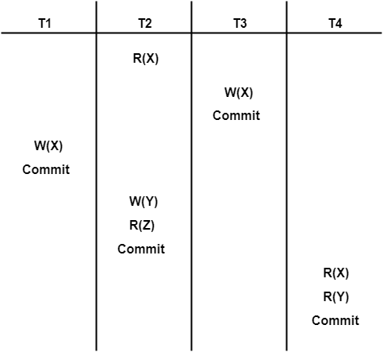

Slide 59
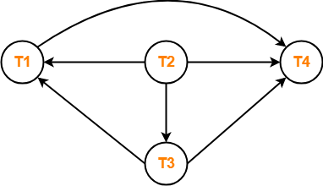

Slide 60
Question: Consider the following schedules involving two transactions. Which one of the following statement is true?
S1: R₁(X) R₁(Y) R₂(X) R₂(Y) W₂(Y) W₁(X) S2: R₁(X) R₂(X) R₂(Y) W₂(Y) R₁(Y) W₁(X)
Both S1 and S2 are conflict serializable
Only S1 is conflict serializable
Only S2 is conflict serializable
None

Slide 61
Only S2 is conflict serializable.

Slide 62
View Serializability
If a given schedule is found to be view equivalent to some serial schedule, then it is called as a view serializable schedule.

Slide 63
View Equivalent Schedules-
Consider two schedules S1 and S2 each consisting of two transactions T1 and T2.
Two schedules S1 and S2 are said to be view equivalent if below conditions are satisfied .
1. Initial Read
2. Updated Read
3. Final Write

Slide 64
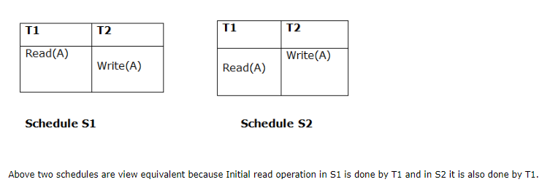
1. Initial Read
An initial read of both schedules must be the same. Suppose two schedule S1 and S2. In schedule S1, if a transaction T1 is reading the data item A, then in S2, transaction T1 should also read A.

Slide 65
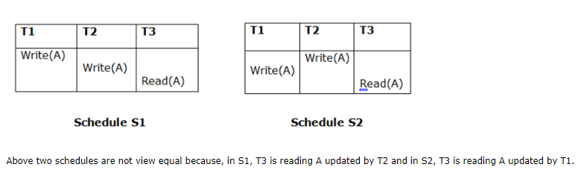
2. Updated Read
In schedule S1, if Ti is reading A which is updated by Tj then in S2 also, Ti should read A which is updated by Tj.

Slide 66
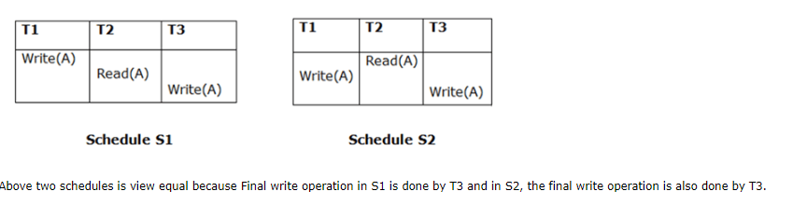
3. Final Write
A final write must be the same between both the schedules. In schedule S1, if a transaction T1 updates A at last then in S2, final writes operations should also be done by T1.

Slide 67
Condition 1 and 2 ensure that each transaction reads the same value in both schedules S1 and S2(so perform same computation).
Condition 3 together with conditions 1 and 2 ensures both schedules result in same final state.

Slide 68
Every conflict serializable schedule is also view serializable .
But all view serializable are not conflict serializable.
Blind writes appear in any view serializable schedule that is not conflict serializable.

Slide 69
View serializability
If a given schedule is found to be view equivalent to some serial schedule, then it is called as a view serializable schedule..
Consider two schedules S1 and S2 each consisting of two transactions T1 and T2. Schedules S1 and S2 are called view equivalent if the following three conditions hold true for them-

Slide 70
1.For each data item Q,if transaction T_{i} reads the initial value of Q in schedule S,then transaction T_{i} must in schedule S’’ also read the initial value of Q.
“Initial reads must be same for all data items”
If transaction T_{i} reads a data item that has been updated by the transaction T_{j} in schedule S1, then in schedule S2 also, transaction T_{i} must read the same data item that has been updated by transaction T_{j.}
“Write-read sequence must be same.”.

Slide 71
For each data item Q ,the transaction that perform the final write(Q) operation in schedule S must perform the final Write(Q) operation in schedule in S”.
“Final writers must be same for all data items”.

Slide 72
How to check whether a given schedule is view serializable or not?
Method-01:
Check whether the given schedule is conflict serializable or not.
If the given schedule is conflict serializable, then it is surely view serializable.
If the given schedule is not conflict serializable, then it may or may not be view serializable. Go and check using other methods.

Slide 73
Method-02:
Check if there exists any blind write operation (writing without reading a value is known as a blind write).
If there does not exist any blind write, then the schedule is surely not view serializable. Stop and report your answer.
If there exists any blind write, then the schedule may or may not be view serializable. Go and check using other methods.

Slide 74
Method-03:
In this method, try finding a view equivalent serial schedule.

Slide 75
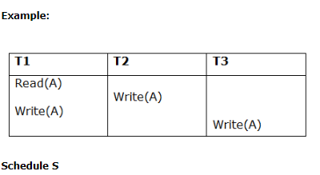
EXAMPLE :
To check whether S is view serializable:-

Slide 76
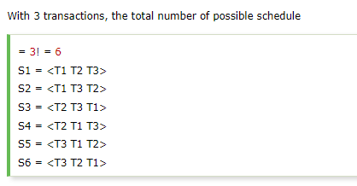
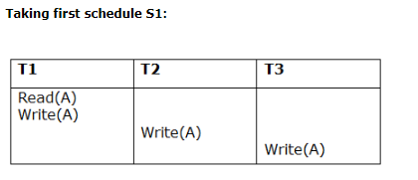
EXAMPLE:SOLUTION

Slide 77
EXAMPLE:- solution
Step 1: final updation on data items
In both schedules S and S1, there is no read except the initial read that's why we don't need to check that condition.
Step 2: Initial Read
The initial read operation in S is done by T1 and in S1, it is also done by T1.
Step 3: Final Write
The final write operation in S is done by T3 and in S1, it is also done by T3. So, S and S1 are view Equivalent.

Slide 78
EXAMPLE:-SOLUTION (conti..)
The first schedule S1 satisfies all three conditions, so we don't need to check another schedule.
Hence, view equivalent serial schedule of S is S1:
T1 → T2→ T3

Slide 79
Irrecoverable Schedules-
If in a schedule,
A transaction performs a dirty read operation from an uncommitted transaction
And commits before the transaction from which it has read the value then such a schedule is known as an Irrecoverable Schedule.

Slide 80
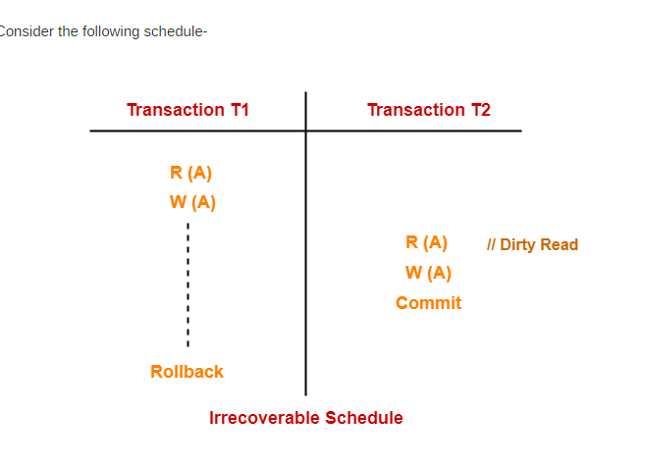
Example:Irrecoverable schedule

Slide 81
Example: Irrecoverable schedule
In the above example
T2 performs a dirty read operation.
T2 commits before T1.
T1 fails later and roll backs.
The value that T2 read now stands to be incorrect.
T2 can not recover since it has already committed.
So the above schedule is an irrecoverable schedule.

Slide 82
Recoverable Schedules-
If in a schedule,
A transaction performs a dirty read operation from an uncommitted transaction.
And its commit operation is delayed till the uncommitted transaction either commits or roll backs then such a schedule is known as a Recoverable Schedule.

Slide 83
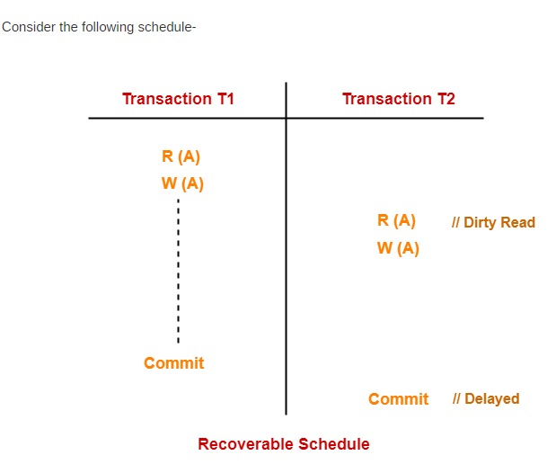
EXAMPLE: Recoverable Schedules-

Slide 84
In the above example T2 performs a dirty read operation.
The commit operation of T2 is delayed till T1 commits or roll backs.
T1 commits later.
T2 is now allowed to commit.

Slide 85
In case, T1 would have failed, T2 has a chance to recover by rolling back.
Since the commit operation of the transaction that performs the dirty read is delayed.
This ensures that it still has a chance to recover if the uncommitted transaction fails later.

Slide 86
Recoverable schedule
Two types:
Cascadeless schedule
Cascading schedule

Slide 87
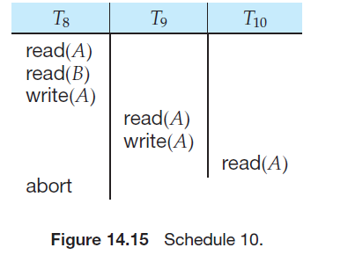
CASCADING SCHEDULE
Even if a schedule is recoverable ,to recover correctly from failure of transaction Ti, we may have to roll back several transaction.
Such situations occur if transactions have read data written by Ti.

Slide 88
In the above example ,transaction T8 has been aborted.
T8 must be rolled back.
Since T9 is dependent on T8, T9 must be rolled back. Since T10 is dependent on T9, T10 must be rolled back.
The phenomenon, in which a single transaction failure leads to a series of transaction rollbacks, is called cascading rollback.

Slide 89
Cascading rollback is undesirable, since it leads to the undoing of a significant amount of work.

Slide 90
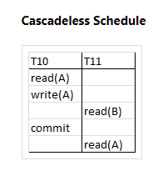
Cascadeless schedule
A cascadeless schedule is one where, for each pair of transactions Ti and Tj such that Tj reads a data item previously written by Ti , the commit operation of Ti appears before the read operation of Tj.
This type of schedule is called cascadeless schedule.

